Slide 1
Microsoft 365 & Power Platform Development – Bi-weekly call
Your host in this call: David Warner (Microsoft)
August 4th, 2022

Slide 2



v
Agenda
Latest Updates
Independent Publisher Connectors
Latest on script samples
Latest Microsoft Teams samples
Latest on Power Platform samples
Picture time with the Together Mode!
Luise Freese - ProvisionGenie v.3.0 - Localization and Accessibility
Chris Kent - List Formatting – Warrior Horses Strike Back!

Slide 3
Opportunities to Participate in the community
Demo solution or technical pattern
Contribute on GitHub
Provide feedback
Great opportunity to get visibility for you or your company. Demo sample or explain how you extend or customize SharePoint Online with live demo in your projects. Reach out to team for volunteering.
Request a demo spot on the call
https://aka.ms/m365pnp/request/demo

Slide 4
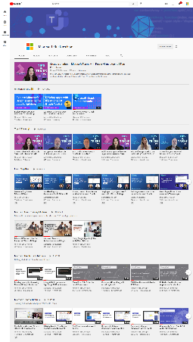
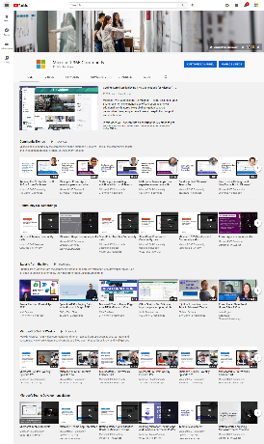
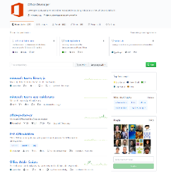
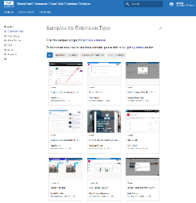
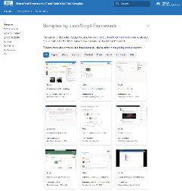
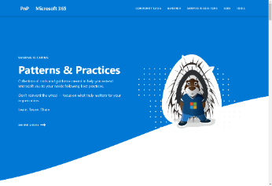
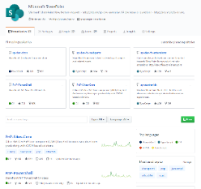
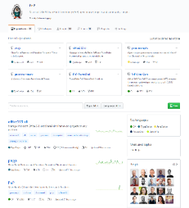
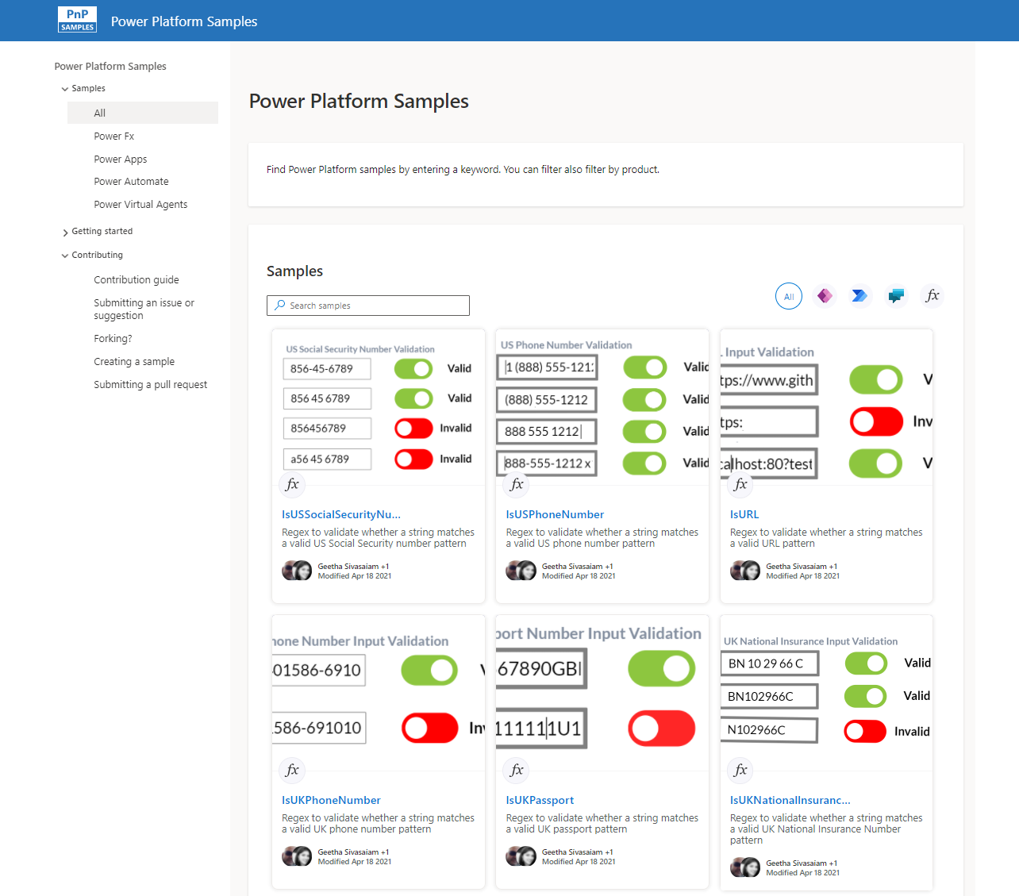
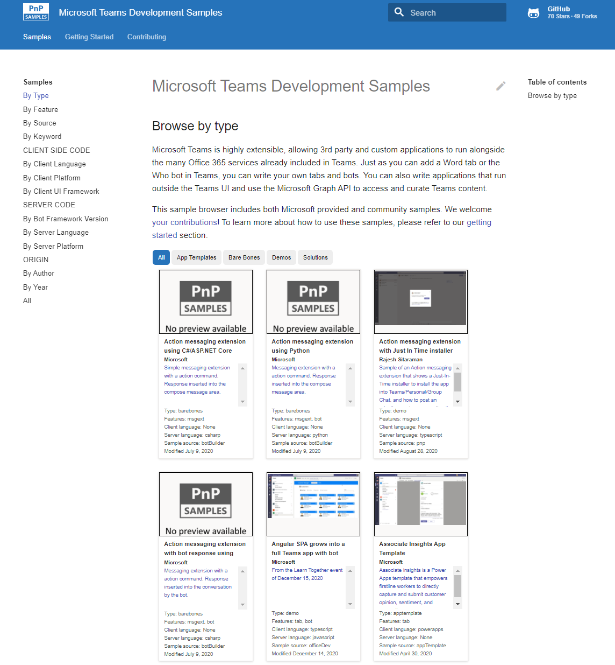
Microsoft 365 developer videos
Microsoft 365 community videos
Open-source
Sample galleries
Open-source initiatives and samples
github.com/sharepoint
github.com/pnp
github.com/officedev
github.com/microsoftgraph
aka.ms/m365/samples
aka.ms/teams-samples
aka.ms/spfx-webparts
aka.ms/powerplatform-samples
aka.ms/spfx-extensions
aka.ms/list-formatting
aka.ms/m365/community
aka.ms/m365devyoutube
aka.ms/m365pnp/videos
@Microsoft365Dev | @m365pnp

Slide 5
Microsoft 365 developer community calls
Microsoft 365 platform (weekly) https://aka.ms/m365-dev-call
(Notice. This call is on a summer break between July 1st and 31st of August 2022)
Adaptive Cards https://aka.ms/adaptivecardscommunitycall
Microsoft identity platform https://aka.ms/IDDevCommunityCalendar
Office Add-ins https://aka.ms/officeaddinscommunitycall
Power Platform https://aka.ms/PowerPlatformMonthlyCall
Microsoft 365 & Power Platform Development (bi-weekly) https://aka.ms/m365-dev-sig
Viva Connections & SharePoint Framework (bi-weekly) https://aka.ms/spdev-spfx-call
Download recurrent invites from
https://aka.ms/m365/calls
Notes:
m365-dev-sig

Slide 6
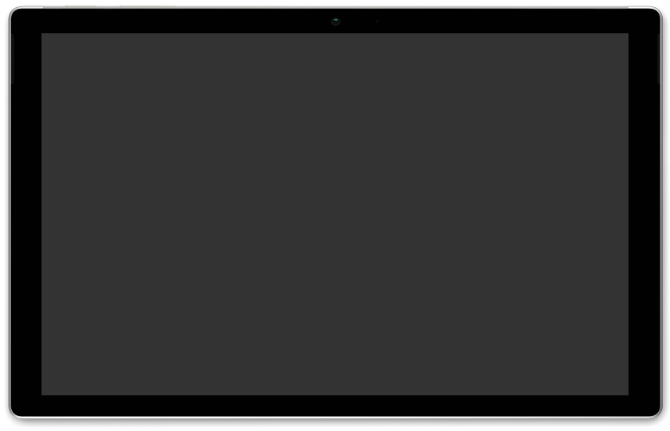
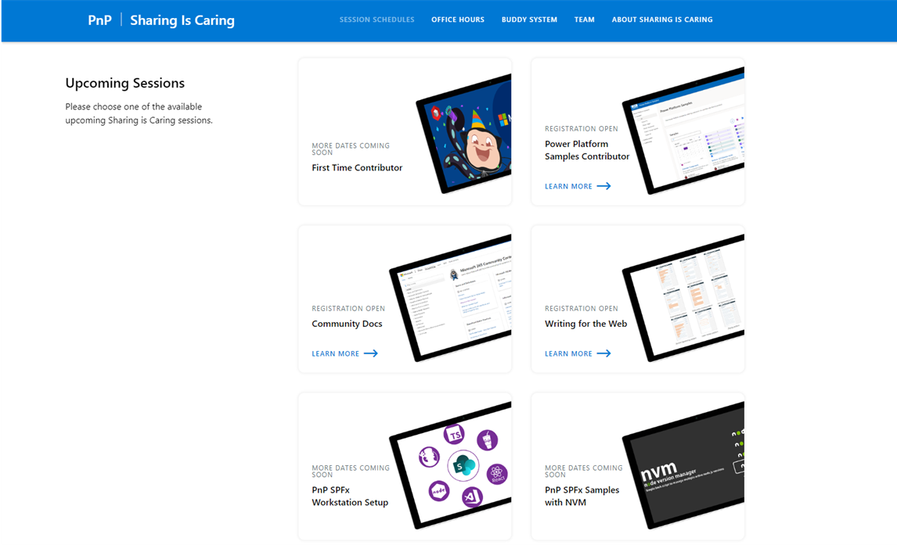
GUIDANCE
Learn how to get started in the open-source PnP community!
Upcoming Sessions:
First-time contributor
Power Platform Samples Contributor
Community Content Docs
SPFx Developer Workstation Setup
Using PnP SPFx samples w/ NVM
More than code with VS Code
First-time presenter
M365 Maturity Model Practitioners
Writing for the Web
Power Platform Samples Contributor
August & September Dates!!!
https://aka.ms/sharing-is-caring
Notes:
25 Total attendees, 16 attendees who attended both First-Time Contributors and Community Docs sessions.

Slide 7





COMMUNITY
PnP Recognition Program
Showcasing your contributions
Powered by Credly
More achievement levels coming soon
https://aka.ms/m365pnp-recognition
Notes:
25 Total attendees, 16 attendees who attended both First-Time Contributors and Community Docs sessions.

Slide 8

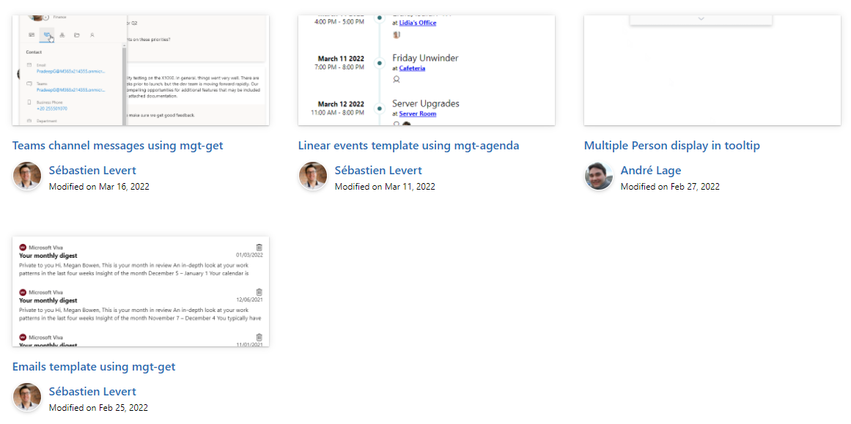

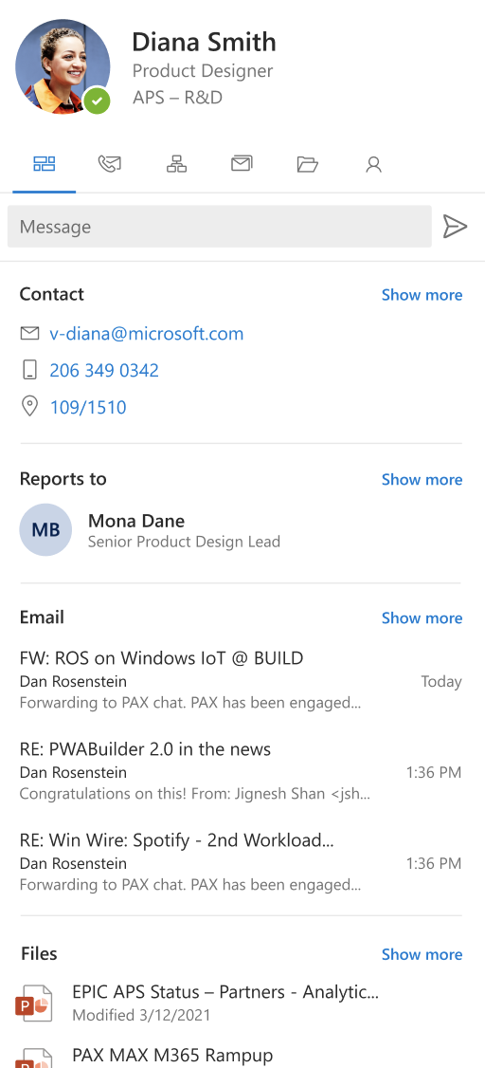
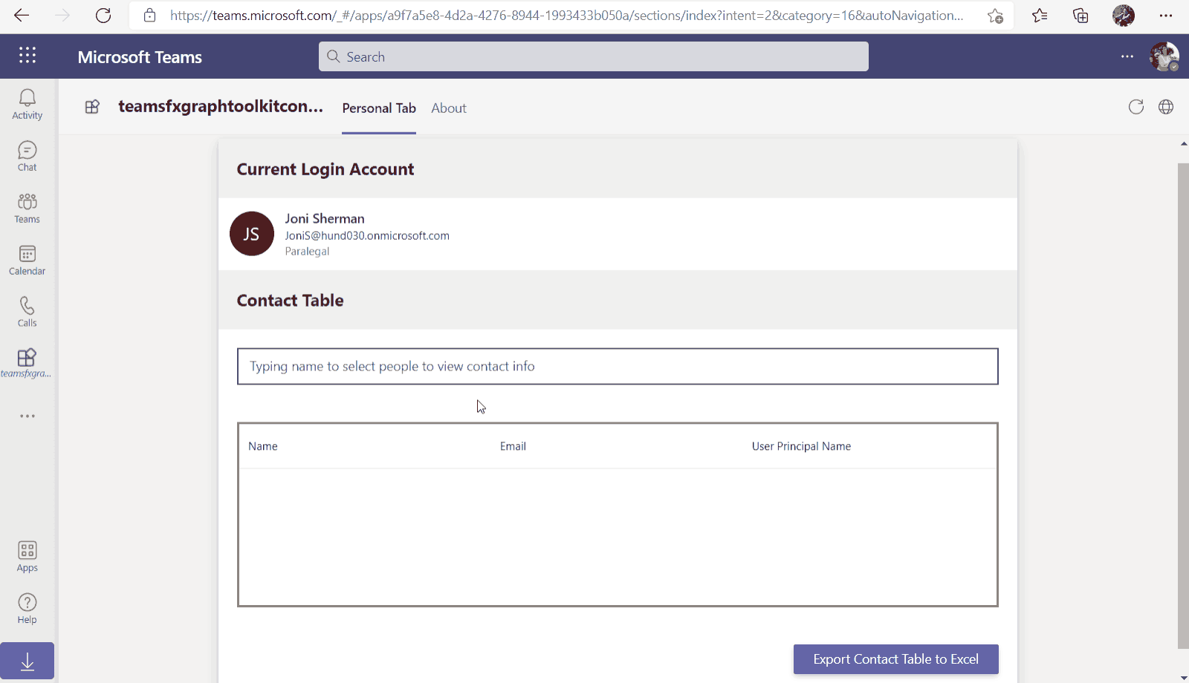
Microsoft Graph Toolkit
👀 More information: aka.ms/mgt
What’s new 🎉
V2.6.0 is our latest release! Update your packages! https://aka.ms/mgt/v2.6.0
Accessibility updates
Support for SPFx 1.15
Documentation on TeamsFx
Updates mgt-people-picker
Thanks @wuxiaojun514 for your contributions 🎉
The MGT samples repository is live! Keep your contributions coming! https://aka.ms/mgt/samples
What's next? 💻
Aligning all Toolkit components to Fluent UI Web Components
More generic components and theming capabilities
We need your help ❤️
🐞 Help us fix bugs
🆕 Help us build/improve features
help-wanted & good-first-issue -> https://aka.ms/mgt/issues

Slide 9

Independent Publisher Connectors
What’s new
53 Awesome Independent Publishers!
158 Independent Publisher connectors!
New connector submissions:
Oleksii Skirko- Microsoft Partner Center
Rene Koch- Snowflake
Troy Taylor- Datamuse
Troy Taylor- Moosend
Troy Taylor- Shadify
Updates to existing connectors:
Chandra Sekhar Malla- Notion
Troy Taylor- Quickbase
Troy Taylor- Schooldigger
We need your help
Become an Independent Publisher by building one of these connectors: Top Connector Asks · microsoft/PowerPlatformConnectors Wiki (github.com)
OR
By adding more functionality to one of the existing Independent Publisher connectors on the Power Platform

Slide 10
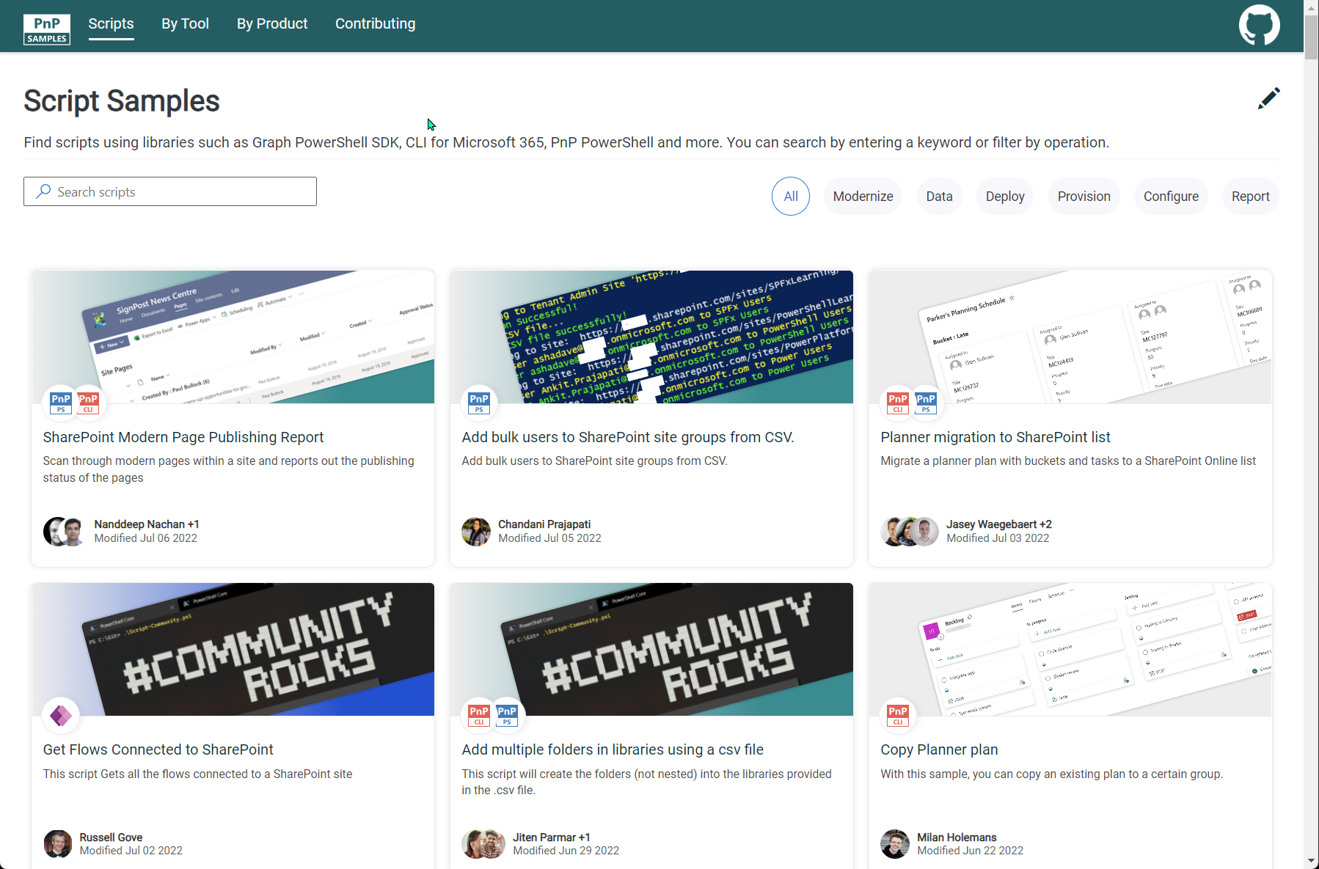
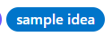
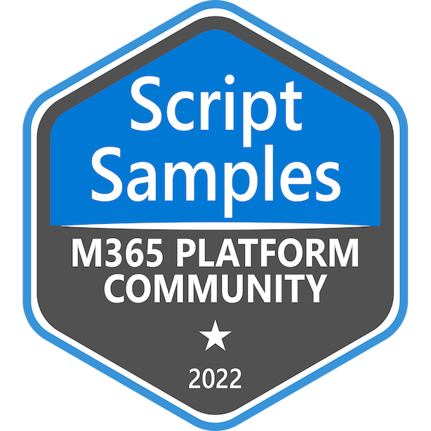

SCRIPT SAMPLES
One centralized location for all scripts for helping your day-to-day life. Contribution's welcome!
Site now has 158 scenarios and 242 scripts, using Microsoft Graph, CLI for Microsoft 365, PnP PowerShell, SPO Management Shell tooling and more…😁 AND samples integrated into "Unified" Solution Gallery
Awesome Samples Include :
New scenario using PnP PowerShell
Update web part properties on modern pages by Ramin Ahmadi
Export SharePoint Term Store terms to CSV by Ramin Ahmadi
New scenarios using CLI for Microsoft 365 Scripts
List external users across all sites and in what site groups by Martin Lingstuyl
Updated Scenarios with CLI for Microsoft 365 Scripts
List all external users in all site collections by Martin Lingstuyl
Updated Scenarios with PnP PowerShell Scripts
Copy Planner plan by Reshmee Auckloo
We have good firsin the GitHub Repo with sample ideas of scripts that you could contribute to ☺ https://github.com/pnp/script-samples
Thank you for your samples and contributions – your awesome and happy holidays! 👏
aka.ms/script-samples
good first issue

Slide 11








Microsoft Teams Samples
Teams JavaScript SDK upgrade – Updated samples wanted! https://aka.ms/TeamsSDK-V2 https://aka.ms/TeamsSDK-V2-Community-Call
New samples would be great as well!
Volunteers Needed!
SAMPLES WANTED!
banner
Check out all the samples! https://aka.ms/m365-samples
Teams samples w/filtering https://aka.ms/teams-samples
Got a cool Teams app to share?
Please contribute – or make use of the samples yourself!
All the samples are at https://aka.ms/m365-samples
Teams samples w/filtering https://aka.ms/teams-samples
Notes:
Wajeed Shaikh – Teams PM

Slide 12
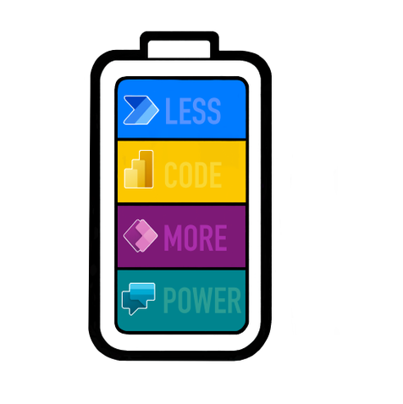
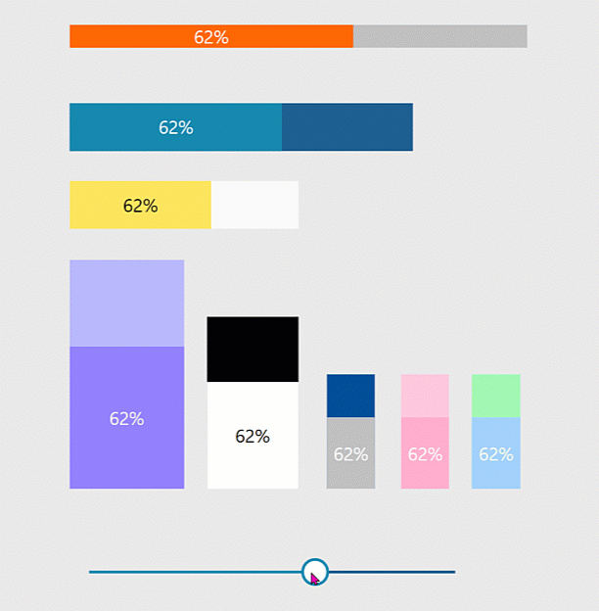




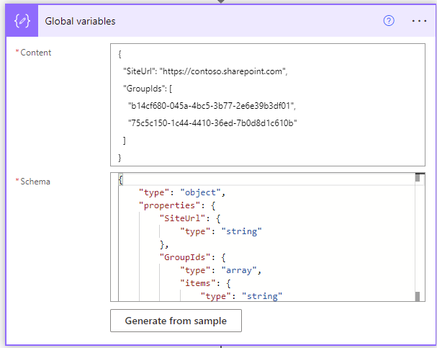
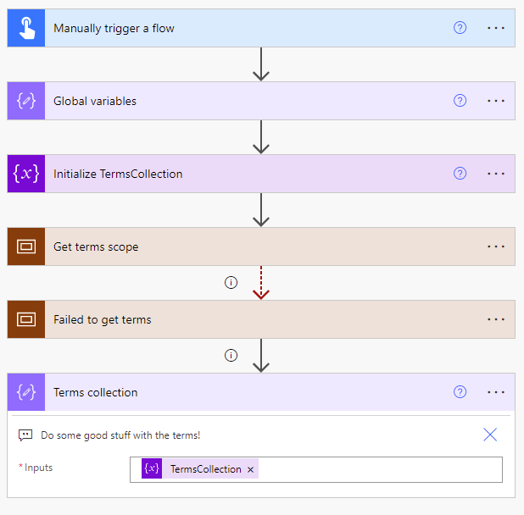
Power Platform Samples
New:
Progress-Bar Components Luise Freese | @LuiseFreese
Get terms from Term Store Ramin Ahmadi | @raminahmadi1986
aka.ms/powerplatform-samples ​
Notes:
These are the updates that we processed since out last call.
New samples:
- Power Automate: SharePoint Collect Feedback April Dunnam | @aprildunnam Demonstrates:
Executing a Flow from a SharePoint Library with input parameters
Leveraging the custom responses option in Power Automate approvals
https://github.com/pnp/powerautomate-samples/tree/main/samples/sharepoint-collect-feedback
- Power Automate: Get Graph API Data within Power BI Reports Scott McKenzie | @365EDUBI Enables Graph API data to be refreshed within the Power BI Service. https://github.com/pnp/powerautomate-samples/tree/main/samples/graph_api_in_power_bi
Updated samples:
Power App: Fluent UI Custom Theme Fabio Franzini | @franzinifabio Fixed datepicker control theme https://github.com/pnp/powerapps-samples/tree/main/samples/fluentui-custom-theme
These latest samples should show within 24 hours

Slide 13
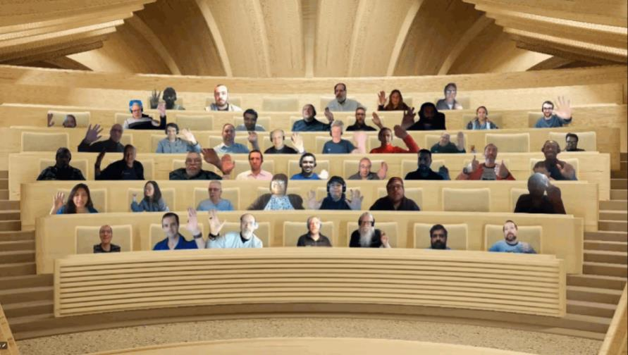

Optional picture time!
Video on and we’ll grab a Together Mode pic with those who are willing to do this.
We are together on this as a community!
By enabling your camera for the picture, you’ll give us the permission to share your picture in social media.

Slide 14
DEMO
ProvisionGenie v.3.0 - Localization and Accessibility – Luise Freese
List Formatting Magic – Warrior Horses Strike Back! – Chris Kent

Slide 15

Q&A

Slide 16
Thank you
Recording will be available in 24 hours on
Microsoft 365 Community (PnP) YouTube channel
https://aka.ms/m365/videos
(subscribe today)
Follow us on Twitter
@Microsoft365Dev | @M365PnP
Next M365 General Dev call: August 18th at 07:00am PT
Next Viva Connections & SharePoint Framework call: August 11th at 07:00am PT
See all other community calls from https://aka.ms/m365/calls

Slide 17



Slide 18
Thank you

